Slide 1

Opioid Crisis in Connecticut
By Christopher Bradway
Dsc 630, Bellevue University
Instructor: Dr. Amirfarrokh iranitalab

Slide 2
Background
The number of opioid related deaths in America has risen to the crisis level.
The state of Connecticut has had a steady increase in opioid related deaths and is one of the hardest hit states when dealing with this crisis.
Once thought to be an inner-city issue, studies have found that the reach of this crisis is a widespread issue, not just inner-city
There have been three waves of various opiates that have effected this state.
First wave 1990’s - 1999 Opioid = Prescription Drugs
Second Wave 2010 – 2013 Opioid = Heroin
Third Wave 2013 - Opioid = Synthetic Opioids (ex. Fentanyl)

Slide 3
Project Objectives
By analyzing past data and creating a predictive model we hope to provide the following information for communities to use in combating the on-going opioid crisis.
Identify opioids by region.
Identify the demographic effected by region.
Predict number of opioid related deaths and opioids involved by county.
Provide details of at-risk demographic for out-reach programs to utilize.

Slide 4
Data Selected
Data was collected from https://catalog.data.gov/dataset/accidental-drug-related-deaths-january-2012-sept-2015.
My dataset has 41 variables and 5104 entries per variable. I am focusing on the following variables; age, race, sex, residence county, cause of death, and opioid consumed. This data covers the years from 2012 – 2018. The data is specifically for the state of Connecticut. Supporting data was extracted from supplemental sources listed in the references. It is important to note that if an opioid is detected at the time of death, but can not be identified, then it is defaulted to other.

Slide 5
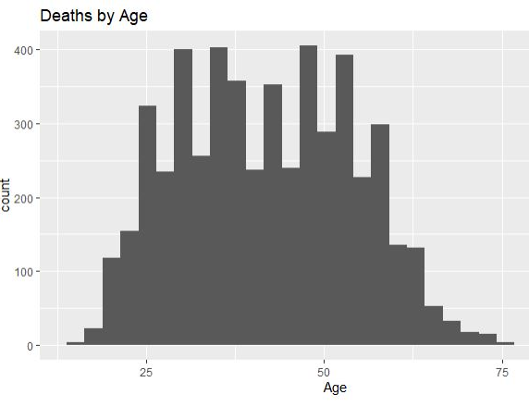
Deaths by Age
If we look at the graph to the right, we see that the ten-year age range that is most effected by the opioid crisis is 45 -55 years.

Slide 6
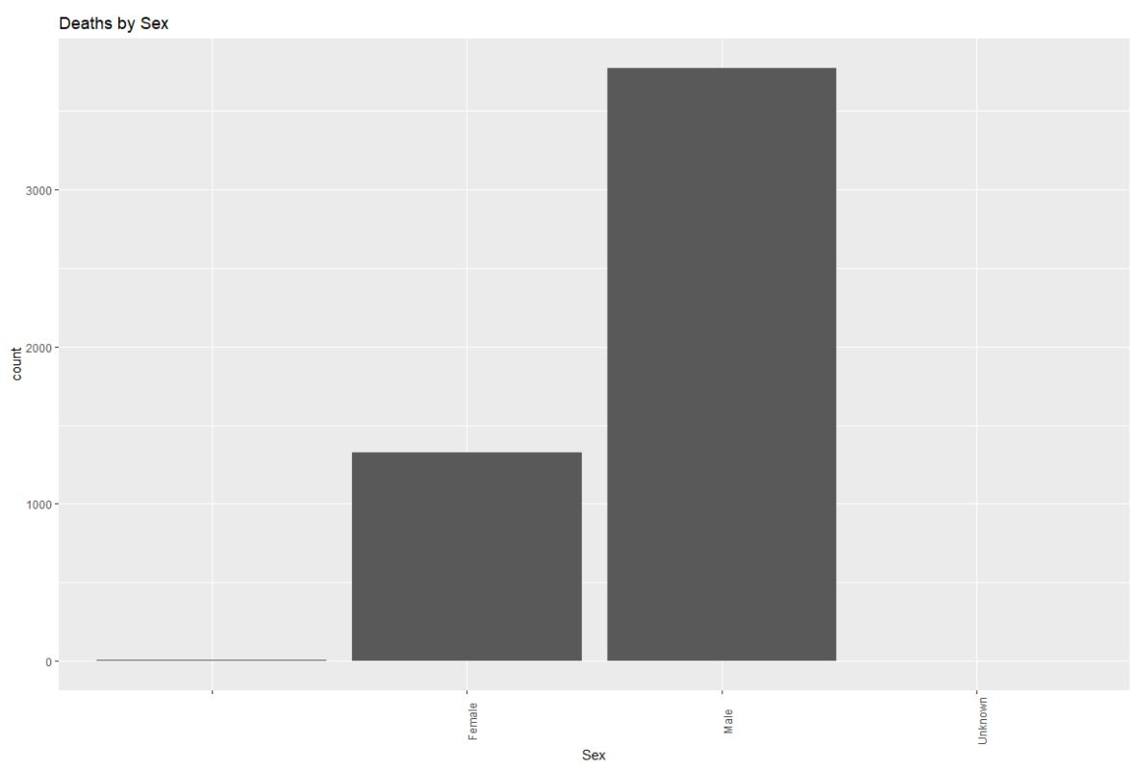
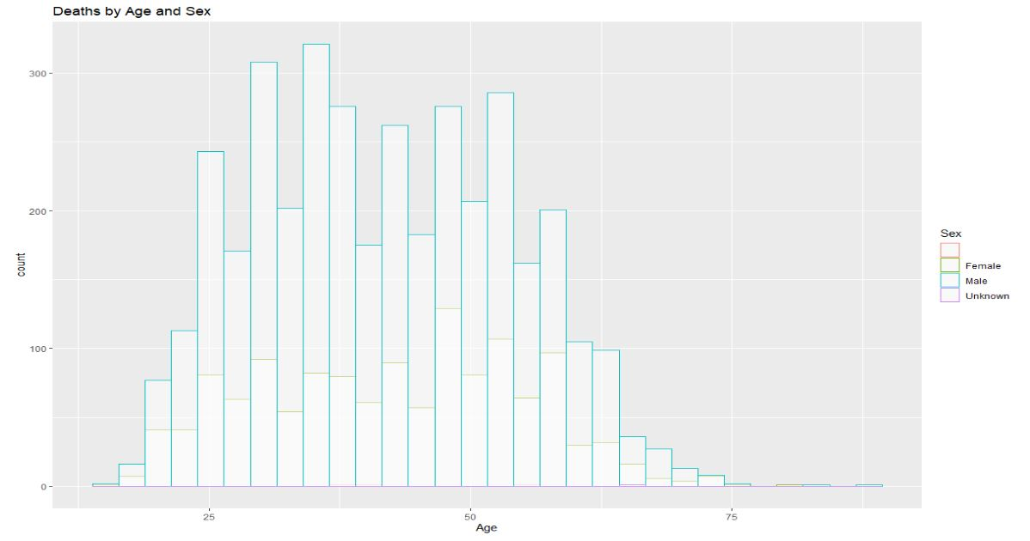
Death by Age/Sex
Almost 4x as many men are Dying
Every age range men are outnumbering the women

Slide 7
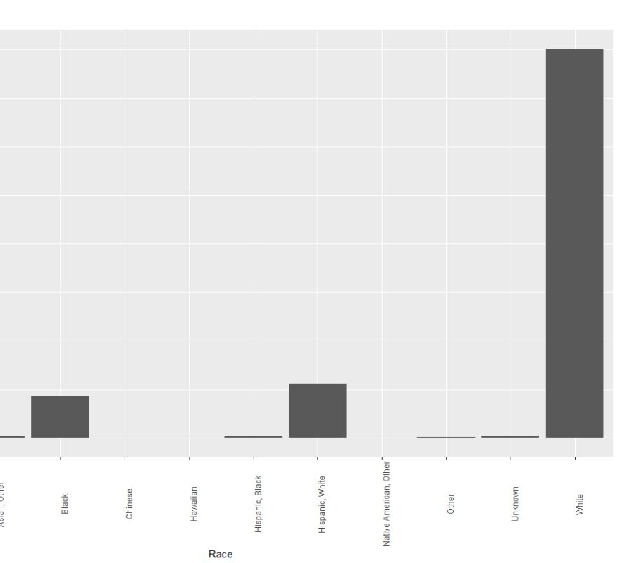
Deaths by Race
The numbers here are staggering. The white community is effected 8 times more than the next closest community.

Slide 8
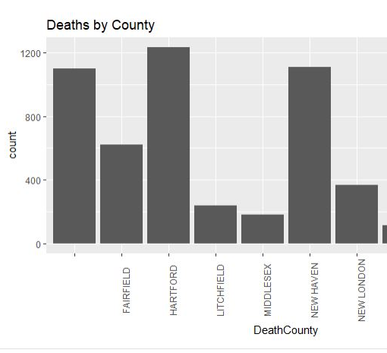
Deaths by County
Here we can see that there are a couple county that are more inflicted by this crisis than others. The one showing the most deaths is Hartford County.

Slide 9
Conclusion: For State of Connecticut
Opioid crisis is not just an inner-city crisis.
45-55 age range most effected.
Men are four times more effected then women.
At every age range the number of men dying are at least twice that of women.
The white community has been effected five times more than any other community.
Hartford county has been dealing with more deaths than any other county in the state of Connecticut.

Slide 10
References:
https://catalog.data.gov/dataset/accidental-drug-related-deaths-january-2012-sept-2015
https://llhd.org/healthy-communities/opioid-use-and-overdose-awareness-and-prevention/#:~:text=In%202016%2C%20917%20residents%20of,predicted%20to%20be%20even%20higher.
https://www.drugabuse.gov/drug-topics/opioids/opioid-overdose-crisis
https://www.cdc.gov/drugoverdose/epidemic/index.html#:~:text=The%20first%20wave%20began%20with,increasing%20since%20at%20least%201999.&text=The%20second%20wave%20began%20in,in%20overdose%20deaths%20involving%20heroin.
https://www.drugabuse.gov/drug-topics/opioids/opioid-summaries-by-state/connecticut-opioid-involved-deaths-related-harms#:~:text=Opioids%20were%20involved%20in%2046%2C802,9.9)%20overdose%20deaths%20in%202018.
https://www.govtech.com/analytics/Behind-the-Data-on-Connecticuts-Opioid-Overdose-Problem.html
https://assets.documentcloud.org/documents/5998085/Opioid-Deaths-All.pdf

